Slide 1
Annamalai University FEAT, Department of ECE Project presentation Design and Verification of Advanced Microcontroller Bus Architecture-Advanced Peripheral Bus (AMBA-APB) Protocol
BY
Arunkumar t
Easwaran s
Prasanth s

Slide 2
Abstract
Advanced Peripheral Bus (APB) is the piece of Advanced Microcontroller Bus Architecture (AMBA) family conventions. The Advanced Peripheral Bus (APB) is a simple, low-power, and low-complexity bus protocol designed for connecting peripheral devices to a microcontroller or system-on-chip (SoC) in embedded systems. It is used to associate low-data transfer capacity peripherals to the SoC(System on Chip). The 32-bit model is developed for communication between Master and Slave devices. The Testbench acts as a Master APB and Design acts as a Slave APB. The Master originates transports on the Peripheral Bus which supports Write, Read, and Idle exchanges

Slide 3
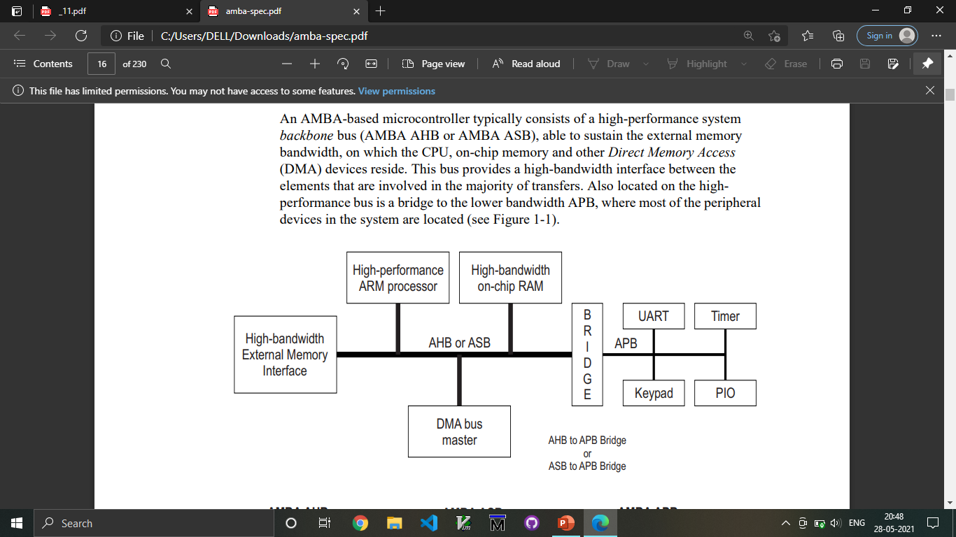
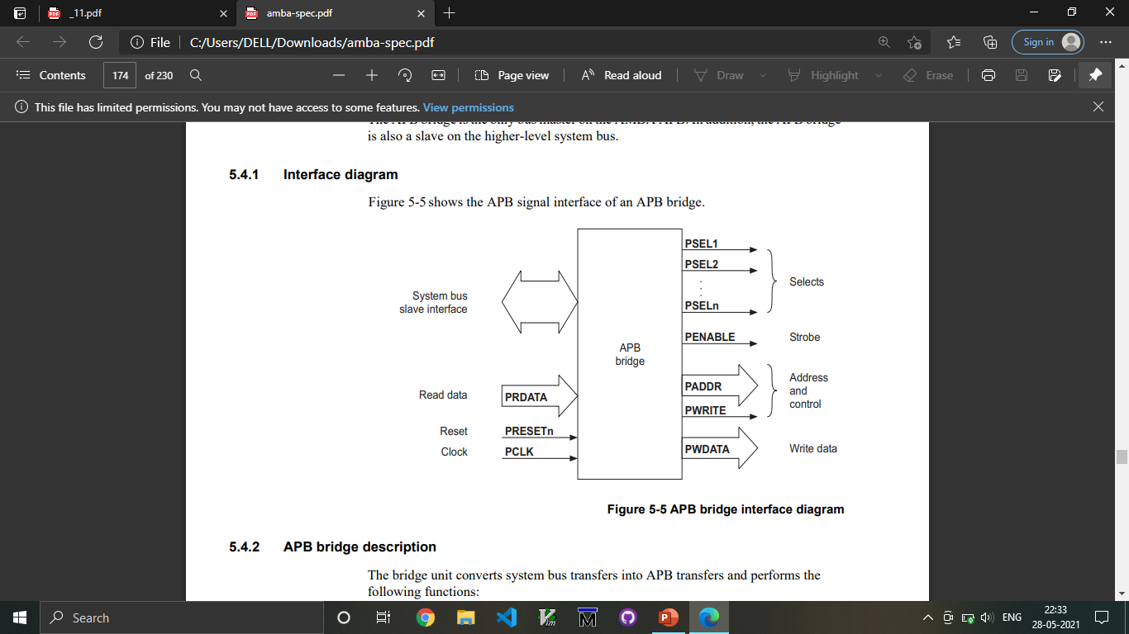
AMBA ARCHITECTURE

Slide 4
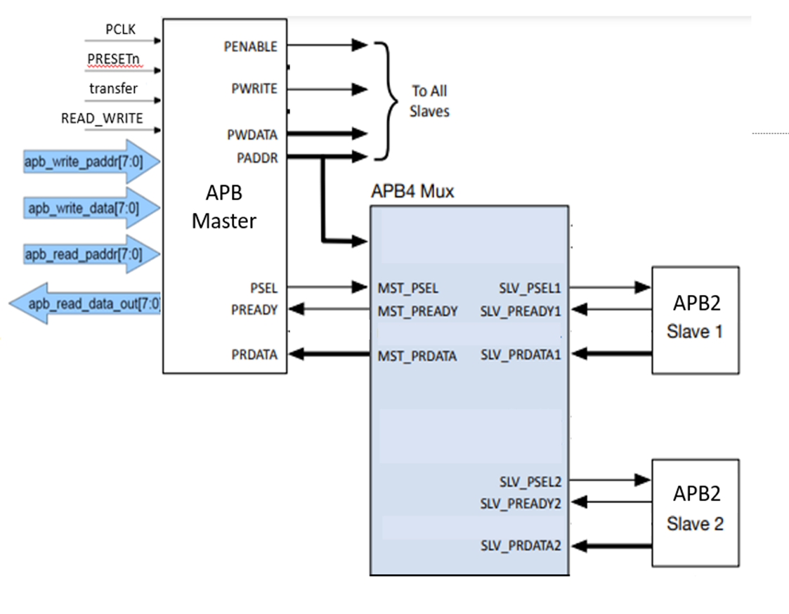
Interface Diagram

Slide 5
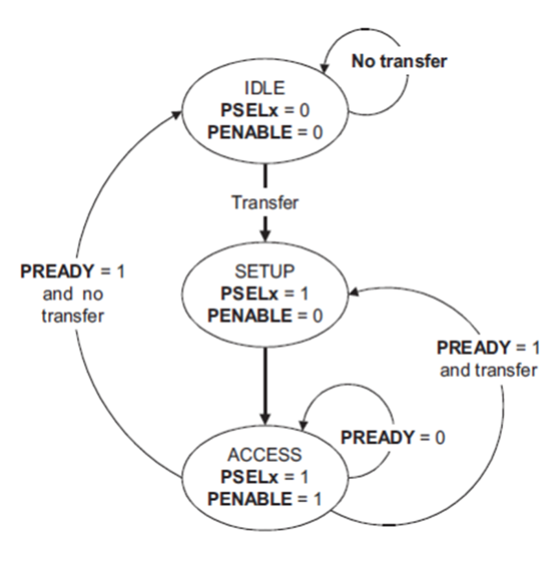
Operation of APB
IDLE
SETUP
ACCESS/ENABLE

Slide 6
PIN Description
SIGNAL | SOURCE | Description | WIDTH(Bit)
Transfer | System Bus | APB enable signal. If high APB is activated else APB is disabled | 1
PCLK | Clock Source | All APB functionality occurs at rising edge. | 1
PRESETn | System Bus | An active low signal. | 1
PADDR | APB bridge | The APB address bus can be up to 32 bits. | 8
PSEL1 | APB bridge | There is a PSEL for each slave. It’s an active high signal. | 1
PENABLE | APB bridge | It indicates the 2nd cycle of a data transfer. It’s an active high signal. | 1

Slide 7
PWRITE | APB bridge | Indicates the data transfer direction. PWRITE=1 indicates APB write access(Master to slave) PWRITE=0 indicates APB read access(Slave to master) | 1
PREADY | Slave Interface | This is an input from Slave. It is used to enter access state. | 1
PSLVERR | Slave Interface | This indicates a transfer failure by the slave. | 1
PRDATA | Slave Interface | Read Data. The selected slave drives this bus during read operation | 8
PWDATA | Slave Interface | Write data. This bus is driven by the peripheral bus bridge unit during write cycles when PWRITE is high. | 8

Slide 8
Moving from Advanced System Bus (ASB) to (APB) is a strategic decision in system design that may be driven by various factors:
Compatibility: APB is better suited for connecting devices like printers or keyboards to a computer. If you're adding these kinds of devices to your system, APB is a better fit.
Less Complexity: APB is simpler and easier to use than ASB. If you don't need all the features and power of ASB, it's more efficient to use APB.
Cost Savings: Using APB can be cheaper because it requires fewer resources and is less complicated to implement.
Good Enough Performance: For many devices, APB works just fine. You might not need the super-fast speeds of ASB for your peripherals.
Flexible and Easy to Use: APB is designed to be flexible and adaptable, making it a good choice for different kinds of devices and setups.
In simple terms, moving from ASB to APB is about choosing the right kind of road for the traffic you're expecting. If you're adding smaller devices to your system, APB is often the better choice.

Slide 9
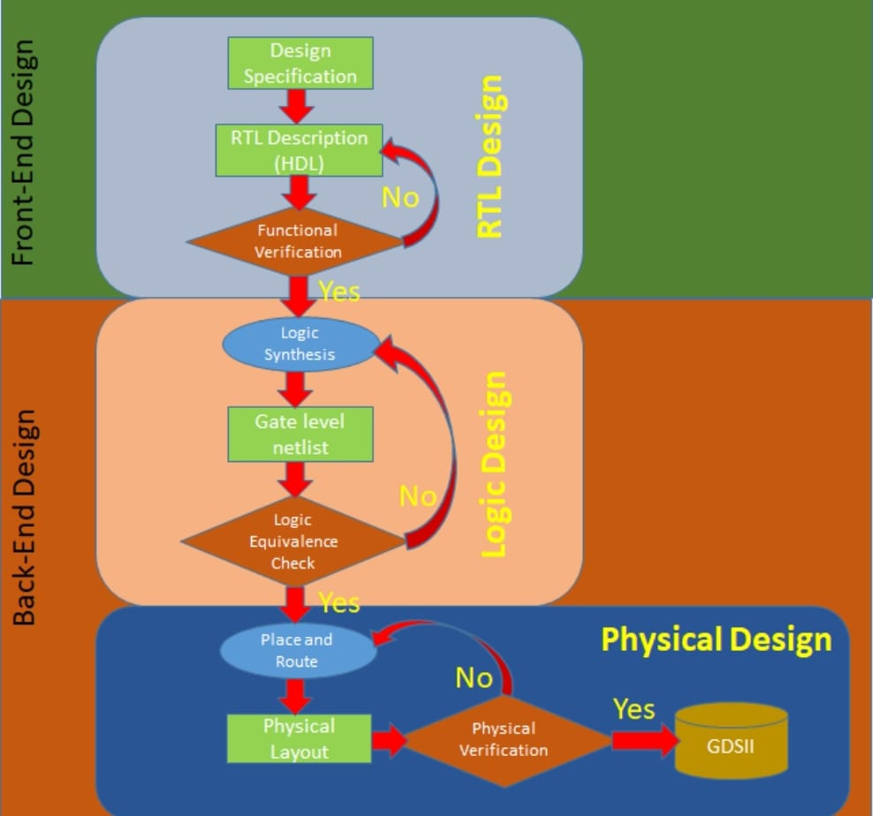
ASIC Flow

Slide 10
Language used : System Verilog
System Verilog is an object-oriented programming that includes data types such as classes and structures, and advanced constructs like interfaces and covergroups, which facilitate efficient verification code development.
Constrained Randomization: System Verilog supports constrained randomization, a powerful technique for generating stimulus to thoroughly exercise the design under test (DUT).
Assertion-Based Verification: Assertions enable formal verification and dynamic checking during simulation, helping detect design errors, corner cases, and violations of specified properties.
Functional Coverage: Functional coverage allows verification engineers to measure the completeness of test suites by tracking which parts of the design have been exercised during simulation. This helps identify verification gaps and refine test bench effectiveness.
Concurrency and Parallelism: System Verilog supports concurrent execution through features like System Verilog processes (fork/join), tasks, and concurrent assertions. These features enable efficient modeling of parallel behavior and concurrency in digital designs, leading to faster simulation and improved verification productivity.

Slide 11
Methodology used : UVM
Integration with UVM: System Verilog is commonly used as the implementation language for Universal Verification Methodology (UVM), a standardized methodology for building reusable and scalable verification environments. UVM leverages System Verilog's features to create modular, configurable, and efficient verification components, promoting best practices in DV.
System Verilog doesn't have a dedicated verification library like UVM, UVM provides a standardized methodology and library of components specifically tailored for verification, making it a popular choice for large-scale verification projects in the semiconductor industry.
They provide a standardized and hierarchical way to define the signals and transactions exchanged between components.

Slide 12
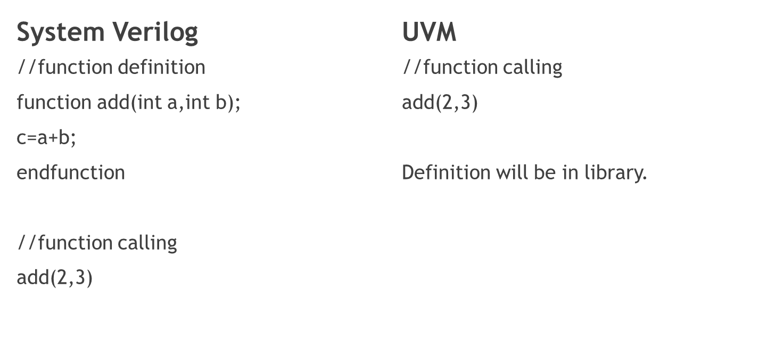
Verification using System Verilog and UVM

Slide 13
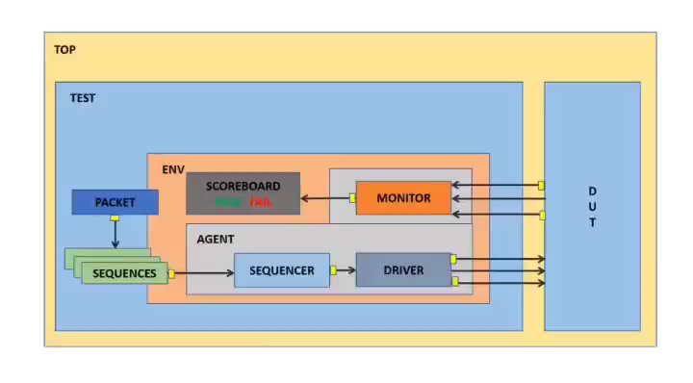
UVM Architecture

Slide 14
UVM Architecture (contd)
Sequence item : It will generate the single set of the Transaction i/p
Sequence : It will generate the multiple set of the Transaction i/p
Sequencer : It will send the Transaction set of i/p 1 by 1 . i.e Arbitration(Process) and Arbiter(Component)
Driver : It will convert Transaction to Pin wiggle
Monitor : It will convert Pin wiggle to Transaction
Scoreboard : It will take the Transaction o/p and compare and check the o/p and give a result as Pass/Fail.
DUT (Design under test)
Interface : Communication channel between DUT and Testbench.

Slide 15
SOFTWARE TOOLS USED
1. GVIM (Text Editor)
2. Questa Sim (System Verilog Compilation, Simulation and Wavefom Visualizer)

Slide 16
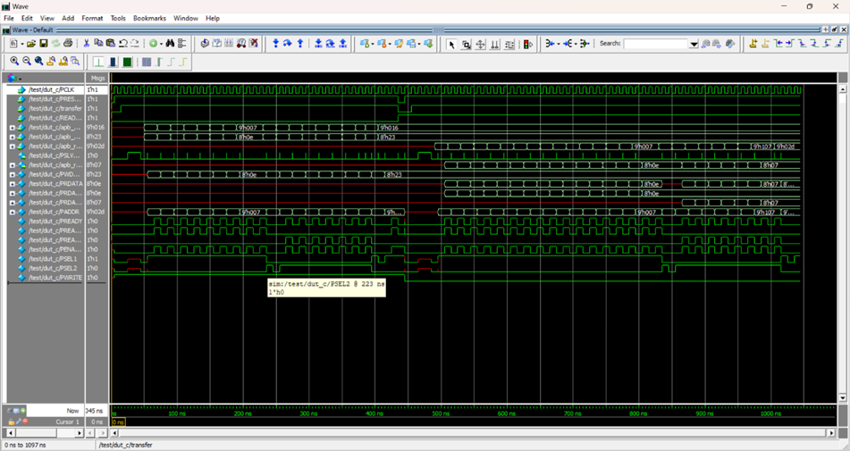
Simulation Results

Slide 17
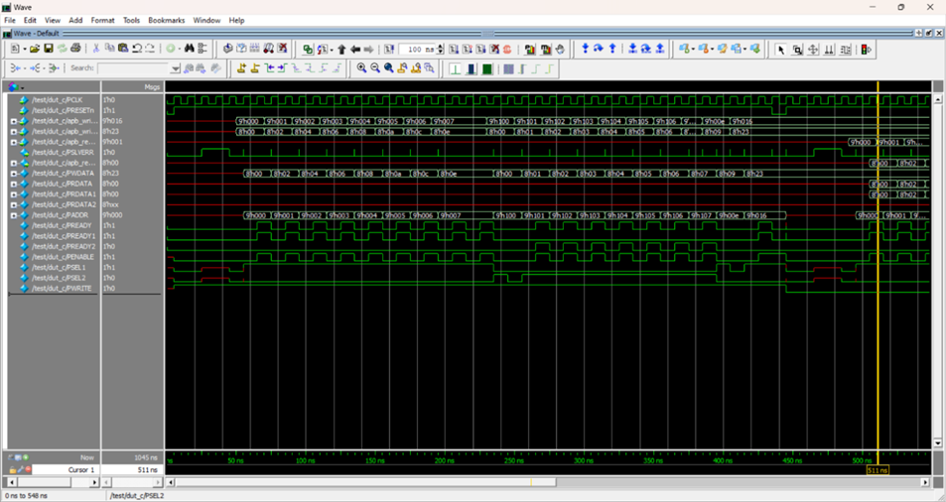
Write operation

Slide 18
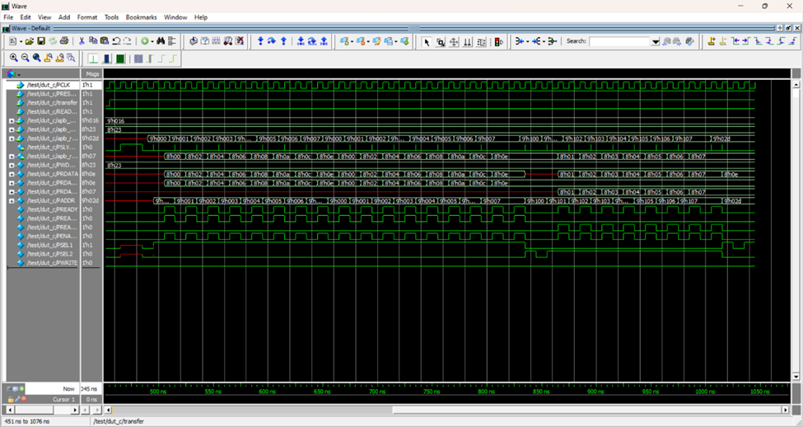
Read Operation

Slide 19
CONCLUSION
The development of the synthesizable APB Bridge in system verilog HDL was done. The PENABLE mechanism was implemented for making it the low-power consuming system. The functional verification of the bridge was done by driving various testcases to the design for testing the features. The multimaster and multislave AHB to APB bridge is one of the future scopes.

Slide 20
THANK YOU

